Slide 2
Operations – Flight Planning Weather -Ethics
Dr Tassos Plioutsias
Assistant Professor of Human Factors
Coventry University
School of Future Transport Engineering

Slide 3
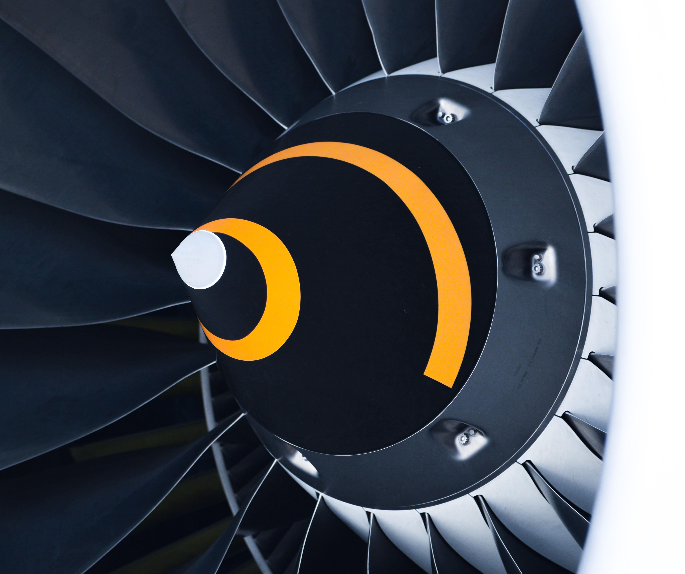
Content
AI in Aviation
Flight Planning
Operations
AI implementations in Aviation
Human Factors considerations

Slide 4
AI Definition.
AI is ‘technology that can, for a given set of human-defined objectives, generate outputs such as content, predictions, recommendations, or decisions influencing the environments they interact with.’
…the theory and development of computer systems able to perform tasks that normally require human intelligence, such as visual perception, speech recognition, decision-making, and translation between languages. ​(Oxford English Dictionary, Oxford Press)​
Frąckiewicz, M. (2023, May 14). The Future of AI in Aviation: Enhancing Safety, Efficiency, and Experience.
TS2 SPACE. https://ts2.space/en/the-future-of-ai-in-aviation-enhancing-safety-efficiency-and-experience/

Slide 5
What means AI into Aviation
AI plays a crucial role in various aspects of the aviation industry, from enhancing flight safety to optimizing airline operations
Airlines, and transportation companies can reduce costs, improve the customer experience, and enhance profitability.
Flight safety is an eminent domain in which artificial intelligence (AI) is utilized within the aviation industry.
AI technologies, such as machine learning algorithms and computer vision systems, are employed for monitoring and analysing data derived from diverse sources, encompassing aircraft sensors, weather reports, and air traffic control systems.
AI-driven systems are currently employed to optimize flight schedules, crew scheduling, and maintenance operations, enabling airlines to reduce costs and improve efficiency.

Slide 6
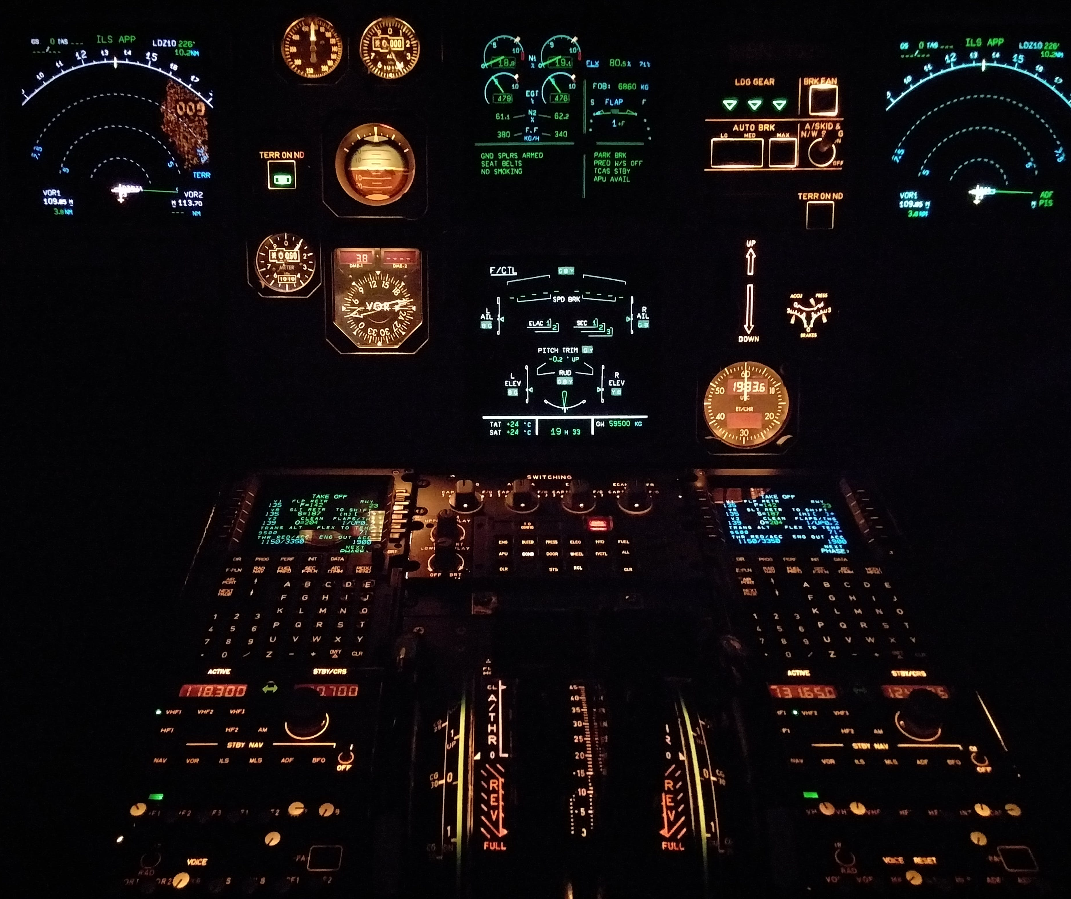
AI in Aviation
AI technology is used to monitor aircraft systems, detect flaws, mitigate risks, and make intelligent decisions to prevent accidents in airline safety.
The utilization of AI in the realm of air traffic control has emerged as a promising approach to mitigating issues related to congestion and delays.
AI is being employed to optimize flight schedules, enabling airlines to achieve cost savings in fuel consumption and other related expenses.
In customer service field, AI has facilitated the provision of round-the-clock assistance and expedited resolution of customer concerns presenting enhanced effectiveness.
The continuous progress in AI technology is expected to significantly increase innovative and transformative applications of AI across various sectors.

Slide 7
Questions for AI
How to establish the public trust into AI-based systems?
How to integrate the ethical dimension of AI (transparency, non-discrimination, fairness, etc.) in safety certification processes?
How to prepare the certification of AI systems?
What standards, protocols, methods do we need to develop to ensure that AI will further improve the current level of safety of road transport?

Slide 8
Eight key Factors
SITUATION AWARENESS: Design options need to consider how AI can support, rather than erode, people’s situation awareness
WORKLOAD: The impact of AI on workload needs to be assessed because AI can both reduce as well as increase workload in certain situations.
AUTOMATION BIAS: Strategies need to be considered to guard against people relying uncritically on the AI, e.g., the use of explanation and training.
EXPLANATION AND TRUST: AI applications should explain their behaviour and allow users to query it to reduce automation bias and to support trust.
HUMAN-AI TEAMING: AI applications should be capable of good teamworking behaviours to support shared mental models and situation awareness.
TRAINING: People require opportunities to practise and retain their skill sets when AI is introduced, and they need to have a baseline understanding of how the AI works.
RELATIONSHIPS BETWEEN X AND Y: The impact on relationships needs to be considered
ETHICAL ISSUES

Slide 9
AI use in Aviation
Flight Simulator Training Devices
Regulations
Test Flights
Autonomous Advance and Urban Air Mobility
Predictive Maintenance
ATM
Aviation Training, EBT/CBTA, CRM/TRM
Weather Prediction
Flight Planning, Route optimization and scheduling

Slide 10
Weather Prediction
A primary reason for ATC delays and course deviations is weather phenomena like Significant Weather phenomena (SIGMETs) and turbulence present major hazards for aircraft. Real-time analysis of these weather developments is computation-intensive and not easily achievable by pilots while flying. AI can provide suggested routing by examining all available variables.
Detecting turbulence mid-flight and the computation of weather models can provide active recommendations to manned and unmanned systems on desirable routes. Given the high probability that more than one flight may be diverted, AI can provide “swarm”-like fleet management.
Artificial intelligence (AI) is being used to improve weather prediction and turbulence detection, which can help to enhance flight safety.
AI-powered weather prediction systems can be used to generate more accurate and up-to-date weather forecasts.
Using AI in weather prediction and turbulence detection transforms how airlines monitor and manage weather-related risks, making air transport safer, more efficient, and more comfortable for passengers

Slide 11
AI in Flight Planning
AI-powered systems are being used to automate tasks, make predictions, and provide recommendations that can help pilots and dispatchers to plan more efficient and safe flights:
Automating tasks: AI-powered systems can automate tasks humans perform, such as weather forecasting and route planning.
Making predictions: AI-powered systems can predict weather conditions, traffic congestions / delays, and other factors affecting flight planning.
Providing recommendations: AI-powered systems can advise pilots and dispatchers about optimum routes, weather conditions, and other factors.

Slide 12
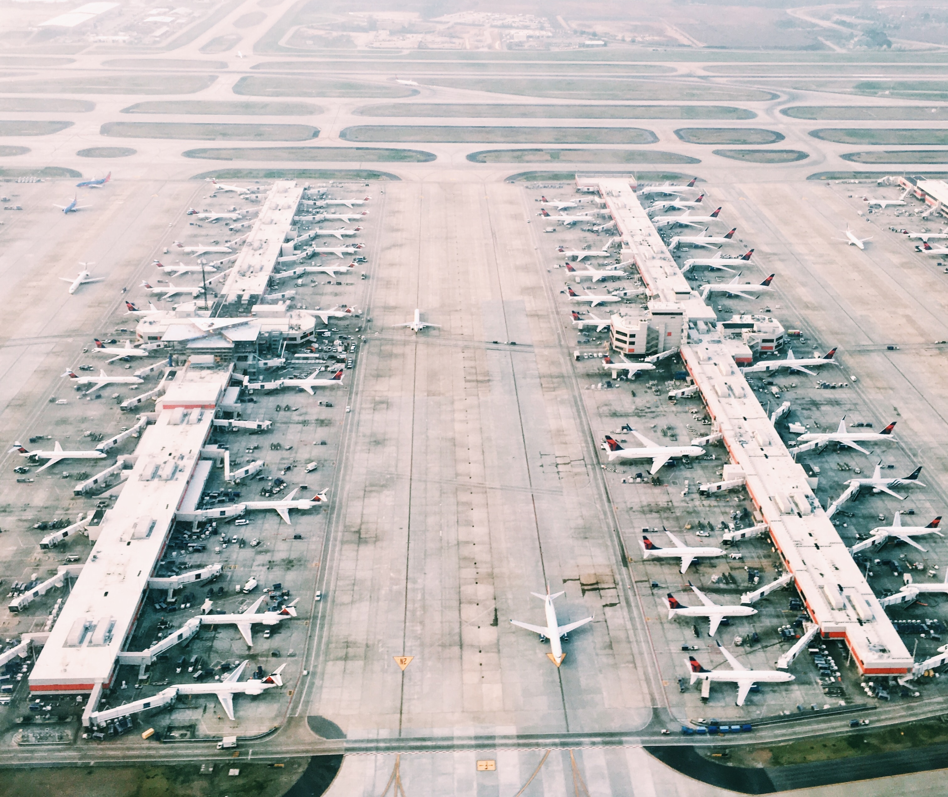
AI in Flight Planning
AI can help pilots and dispatchers plan more efficient and safe flights:
Reduced workload: AI-powered systems can help to reduce the workload on pilots and dispatchers by automating tasks.
Improved safety: AI-powered systems can help to improve safety by providing pilots and dispatchers with more accurate and up-to-date information.
Enhanced situational awareness help aviation ecosystem in the decision-making process.
Increased efficiency: AI-powered systems can increase efficiency by automating tasks and providing recommendations following optimization principles.

Slide 13
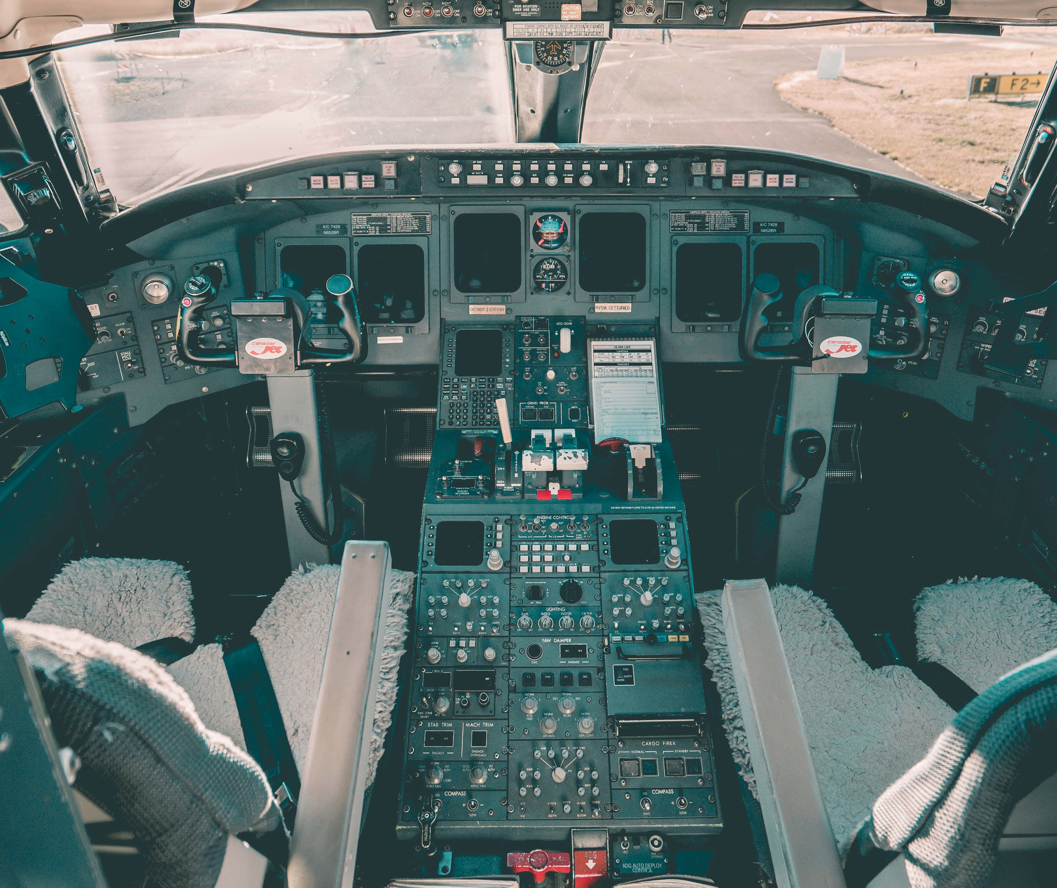
AI in Flight Planning
Weather Forecasting: AI analyses weather data and predicts weather patterns, allowing airlines to plan flights avoiding adverse weather conditions and reduce delays.
Aircraft Performance: AI is being used to optimize flight plans based on aircraft performance data, considering factors such as fuel consumption, speed, and altitude.
Route Optimisation: AI optimizes flight routes, considering factors such as wind patterns, weather, airspace restrictions, and airport congestion.
Airport Operations: AI optimizes airport operations, considering gate availability, ground handling capacity, and passenger traffic.
Flight Planning Software: AI is used to develop flight planning software to analyse substantial amounts of data and optimize flight plans in real-time.

Slide 14
AI in flight crew scheduling
AI-powered systems can optimize crew schedules by considering numerous factors, such as crew availability, flight schedules, and regulatory requirements.
AI optimizes crew pairings based on crew availability, qualifications, bidding, and seniority.
AI-powered systems can predict crew fatigue by analysing a range of factors, such as flight crew duty hours, sleep patterns, and stress levels.
AI-powered systems can reduce crew costs by identifying opportunities to consolidate crew positions or reduce the number of crew members required on flights – standby duties and positioning.
AI develop automated crew scheduling software to generate schedules quickly and efficiently. Also, develop machine learning algorithms to learn from past crew scheduling data and optimize crew assignments in real time.

Slide 15
AI-applications in airport management, security, and surveillance systems
Resource Allocation
Passenger Flow Optimisation
Predictive Maintenance for the equipment
Energy Management
Passenger flow optimization
Predictive analytics
Recommendation engines, services and amenities
Self-service kiosks, save time.

Slide 16
Airport Security
Video Surveillance
Facial Recognition
Behaviour Analysis
Threat Detection
Predictive Analytics
Automated Access Control
Real-time Alerting
Data Analysis and Forensics

Slide 17
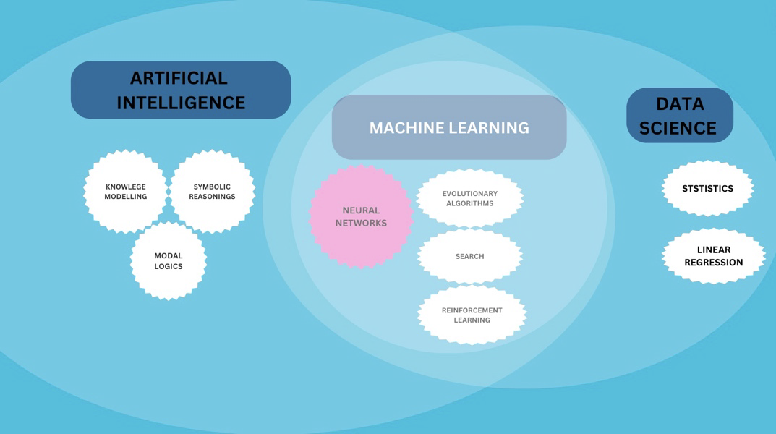
Fundamentals of AI, ML, and Data Science

Slide 18
Constraints
Legal
Ethical / Transparency
Historical (Bias)
User’s biases and prejudices
Security

Slide 19
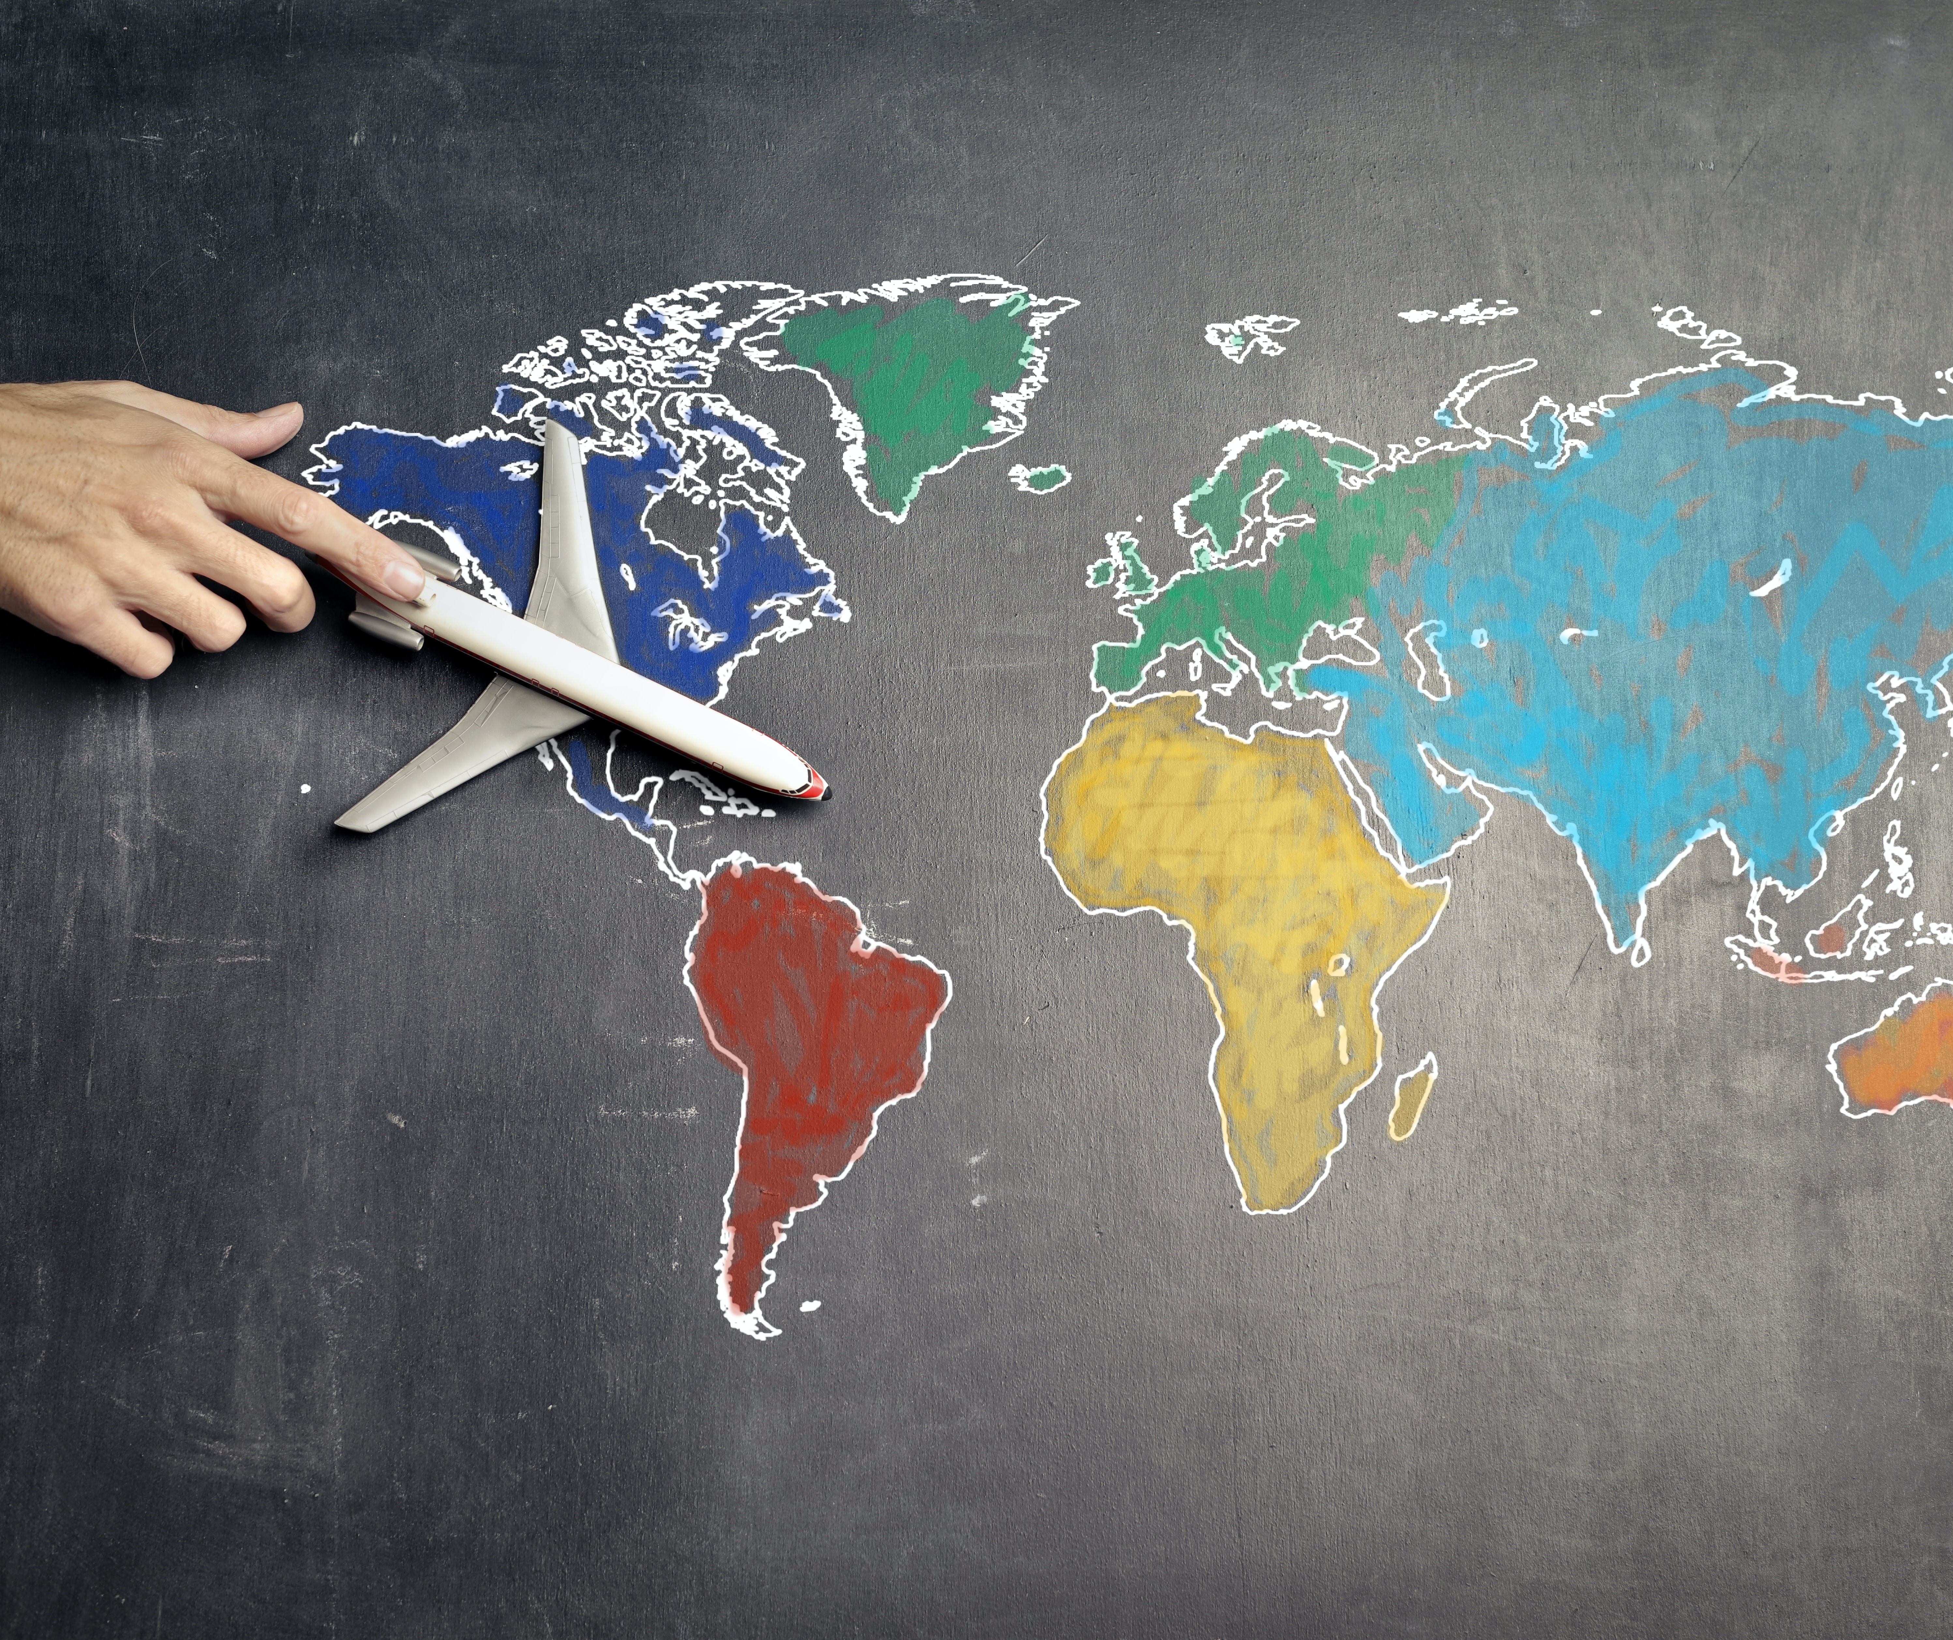
Why AI is Important
Speed of AI Implementation
Potential Impacts on Society
Prioritizing of AI by Every Large Tech Company
Shortage of Knowledgeable Workers
Competitive Advantages for Companies who First Apply AI Correctly
Legal Implications Worldwide
Ethical Development
Communication of Advantages and Opportunities
Collaboration Between Private and Public Sectors
Notes:
Speed of AI Implementation: New AI technologies are being introduced at an incredibly fast pace and it can be difficult to keep up. At this point in time, only a handful of people truly understand all of the implications these quickly evolving technologies will have for our world.
Potential Impacts on Society: It’s hard to imagine the sheer number of things that AI will be able to improve, transform or create, as we begin to apply it to so many different areas of life.
Prioritizing of AI by Every Large Tech Company: Even Google, a company that used to say that mobile was its first priority, has shifted its focus toward AI. Nearly every tech company is heavily investing in AI research and development, which clearly demonstrates the importance that AI holds for businesses in general.
Shortage of Knowledgeable Workers: Because AI is growing so rapidly, there is a great need for more data scientists, machine learning experts, and other technical professionals who can build out AI solutions and services.
Competitive Advantages for Companies who First Apply AI Correctly: Both big and small companies can apply AI, and those who do it first, and correctly, will enjoy stunning competitive advantages.
Legal Implications Worldwide: In almost every country, laws and regulations will need to be reviewed and updated to incorporate the new trends of the AI era. There is also a demand for information on the ways that societies can benefit by applying AI to various fields like healthcare and transportation.
Ethical Development: As we prepare for the growth of AI, we need to push companies to develop new technologies ethically and responsibly, to better serve humanity and improve standards of living around the world. While this is easier said than done, these types of policies really need to be implemented sooner rather than later as AI continues to develop.
Communication of Advantages and Opportunities: People who work for tech companies tend to offer the most positive outlook on the future opportunities that will be afforded by AI. However, outside of that sector, people often have negative impressions about AI tools due to a lack of understanding. Sharing information about the benefits offered by AI will be an important factor in helping people to feel comfortable with adopting these new technologies.
Collaboration Between Private and Public Sectors: Research and development of AI should not only be taking place in large tech companies. Instead, there needs to be strong and open collaboration internationally, as well as between companies of all sizes, and between the public and private sectors. There are several sector that will change completely thanks to artificial intelligence and one example of that is the travel and hotel industries. The article “7 Ways on How Artificial Intelligence (AI) Is Transforming the Travel and Hotel Industries“ shares more details about the future of travel and hotel industry.

Slide 20
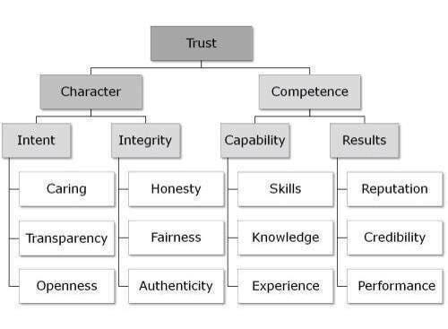
Restrictions and constrains
Lack of understanding
Lack of proper AI strategy
Lack of data
AI skills gap
Cost and time
Lack of trust
Cybersecurity and ethics
Notes:
1. Lack of understanding: one limitation is that leadership often fails to realize the transformative impact AI can have on a company and the opportunities it provides. It is crucial to understand what tools and AI technologies are available to a company, as they are ever-increasing. In addition, managers should analyze when to implement different AI projects and have the critical mindset to prioritize the most critical AI projects that need to be implemented first.
2. Lack of proper AI strategy: A lacking AI strategy is a significant limitation to implementing the technology. Businesses must develop a strong core team and find help from external consultants to overcome integration challenges.
4. Lack of data: Many companies suffer from a lack of data or data silos, which means it is isolated and doesn’t interact across business divisions. This is why every company must learn more about managing its data and how to use it to generate business value. Several AI consultant companies report that 80% of the AI project is generally related to data management and preparation.
4. AI skills gap: Companies often hire new employees to take over AI-related tasks. However, it is much more recommendable and far less risky to reskill and upskill existing employees and give everyone good training on AI and what opportunities it can provide to companies. There are several free artificial intelligence courses, such as the one from Helsinki University.
5. Cost and time: The cost and time required for AI solutions might make a company reconsider using it, but patience is needed as it can result in huge gains down the line. Due to the Covid-19 crisis some companies are forced to look for a quick return on their AI projects. However, the leading value companies can is the know-how to implement AI projects in the future.
6. Lack of trust: Because of a lack of understanding of AI algorithms and technology and how they can be used to generate business value, leadership can lose its confidence in the importance of AI projects. Teams that work on AI projects should be provided with a proper atmosphere so that they don’t feel too pressured, which will impact the outcome of the project.
7. Cybersecurity and ethics: Cyber-attacks are an increasing threat, especially as more businesses move online due to COVID-19. This can hinder an organization, so it’s essential to take adequate measures against these threats. A breach of ethics can also stop the business from moving further ahead and result in scrutiny. It’s essential to follow the legislation regarding data. Also in the earlier blog post we covered the unethical use of artificial intelligence.

Slide 21
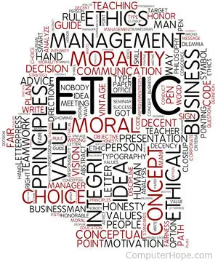
Human Factors Considerations in Human Machine Interaction, AI in Aviation
Cockpit Interfaces
Air Traffic Management
Autonomous Vehicles
Passenger Experience
Training and Support
Trust and Transparency
Ethical Considerations

Slide 22
AI & Human Factors
People will adapt with what they’re given...
Even the best people make big mistakes...
Right job, wrong equipment...
Knowing that a hazard is there DOESN’T always protect you…
Controls don’t always do what you expect them to do...
SOP’s aren’t enough...
Time to stop...
When sleep comes nothing can stop it...
Find a way to do it – humans are resourceful...
Notes:
The various sub-fields of AI research are centered around particular goals and the use of particular tools. The traditional goals of AI research include reasoning, knowledge representation, planning, learning, natural language processing, perception, and the ability to move and manipulate objects.^{[a]} General intelligence (the ability to solve an arbitrary problem) is among the field's long-term goals.^{[12]} To solve these problems, AI researchers have adapted and integrated a wide range of problem-solving techniques – including search and mathematical optimization, formal logic, artificial neural networks, and methods based on statistics, probability and economics. AI also draws upon computer science, psychology, linguistics, philosophy, and many other fields.
The field was founded on the assumption that human intelligence "can be so precisely described that a machine can be made to simulate it".^{[b]} This raised philosophical arguments about the mind and the ethical consequences of creating artificial beings endowed with human-like intelligence; these issues have previously been explored by myth, fiction and philosophy since antiquity.^{[14]} Computer scientists and philosophers have since suggested that AI may become an existential risk to humanity if its rational capacities are not steered towards beneficial goals.^{[c]}

Slide 23
AI in Aviation
Aviation is one part of the greater mobility upgrade plan for the next 20 years
AI provides solutions for decision making
Data analysis for potential solutions, acts and decisions.
Humans remains part of the system and the last barrier.

Slide 24
Questions?
Dr Tassos Plioutsias
Coventry University

